Slide 1
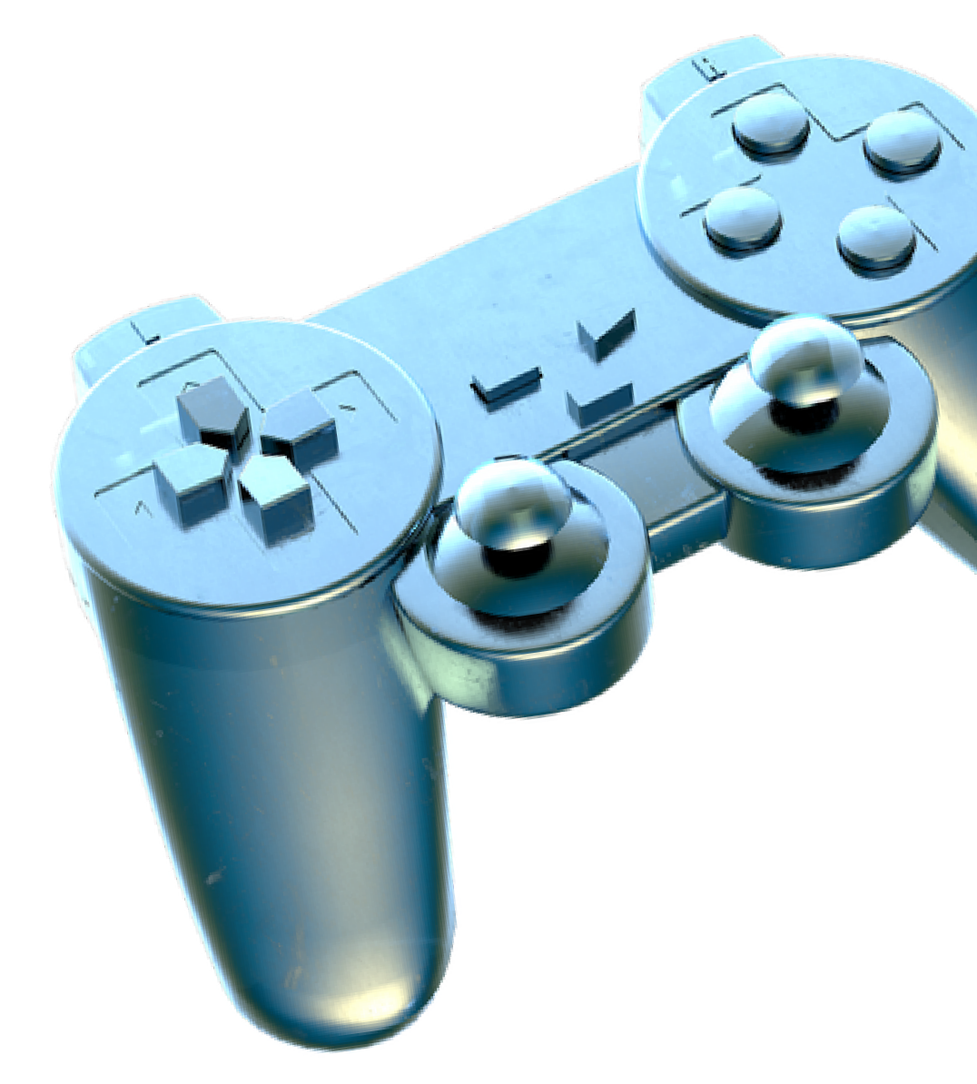

JUNK FOOD CLASSIFICATION
NAME:
U PREMKUMAR
DEPT: IIIrd year BE-CSE REG NO: 211521104117

Slide 2
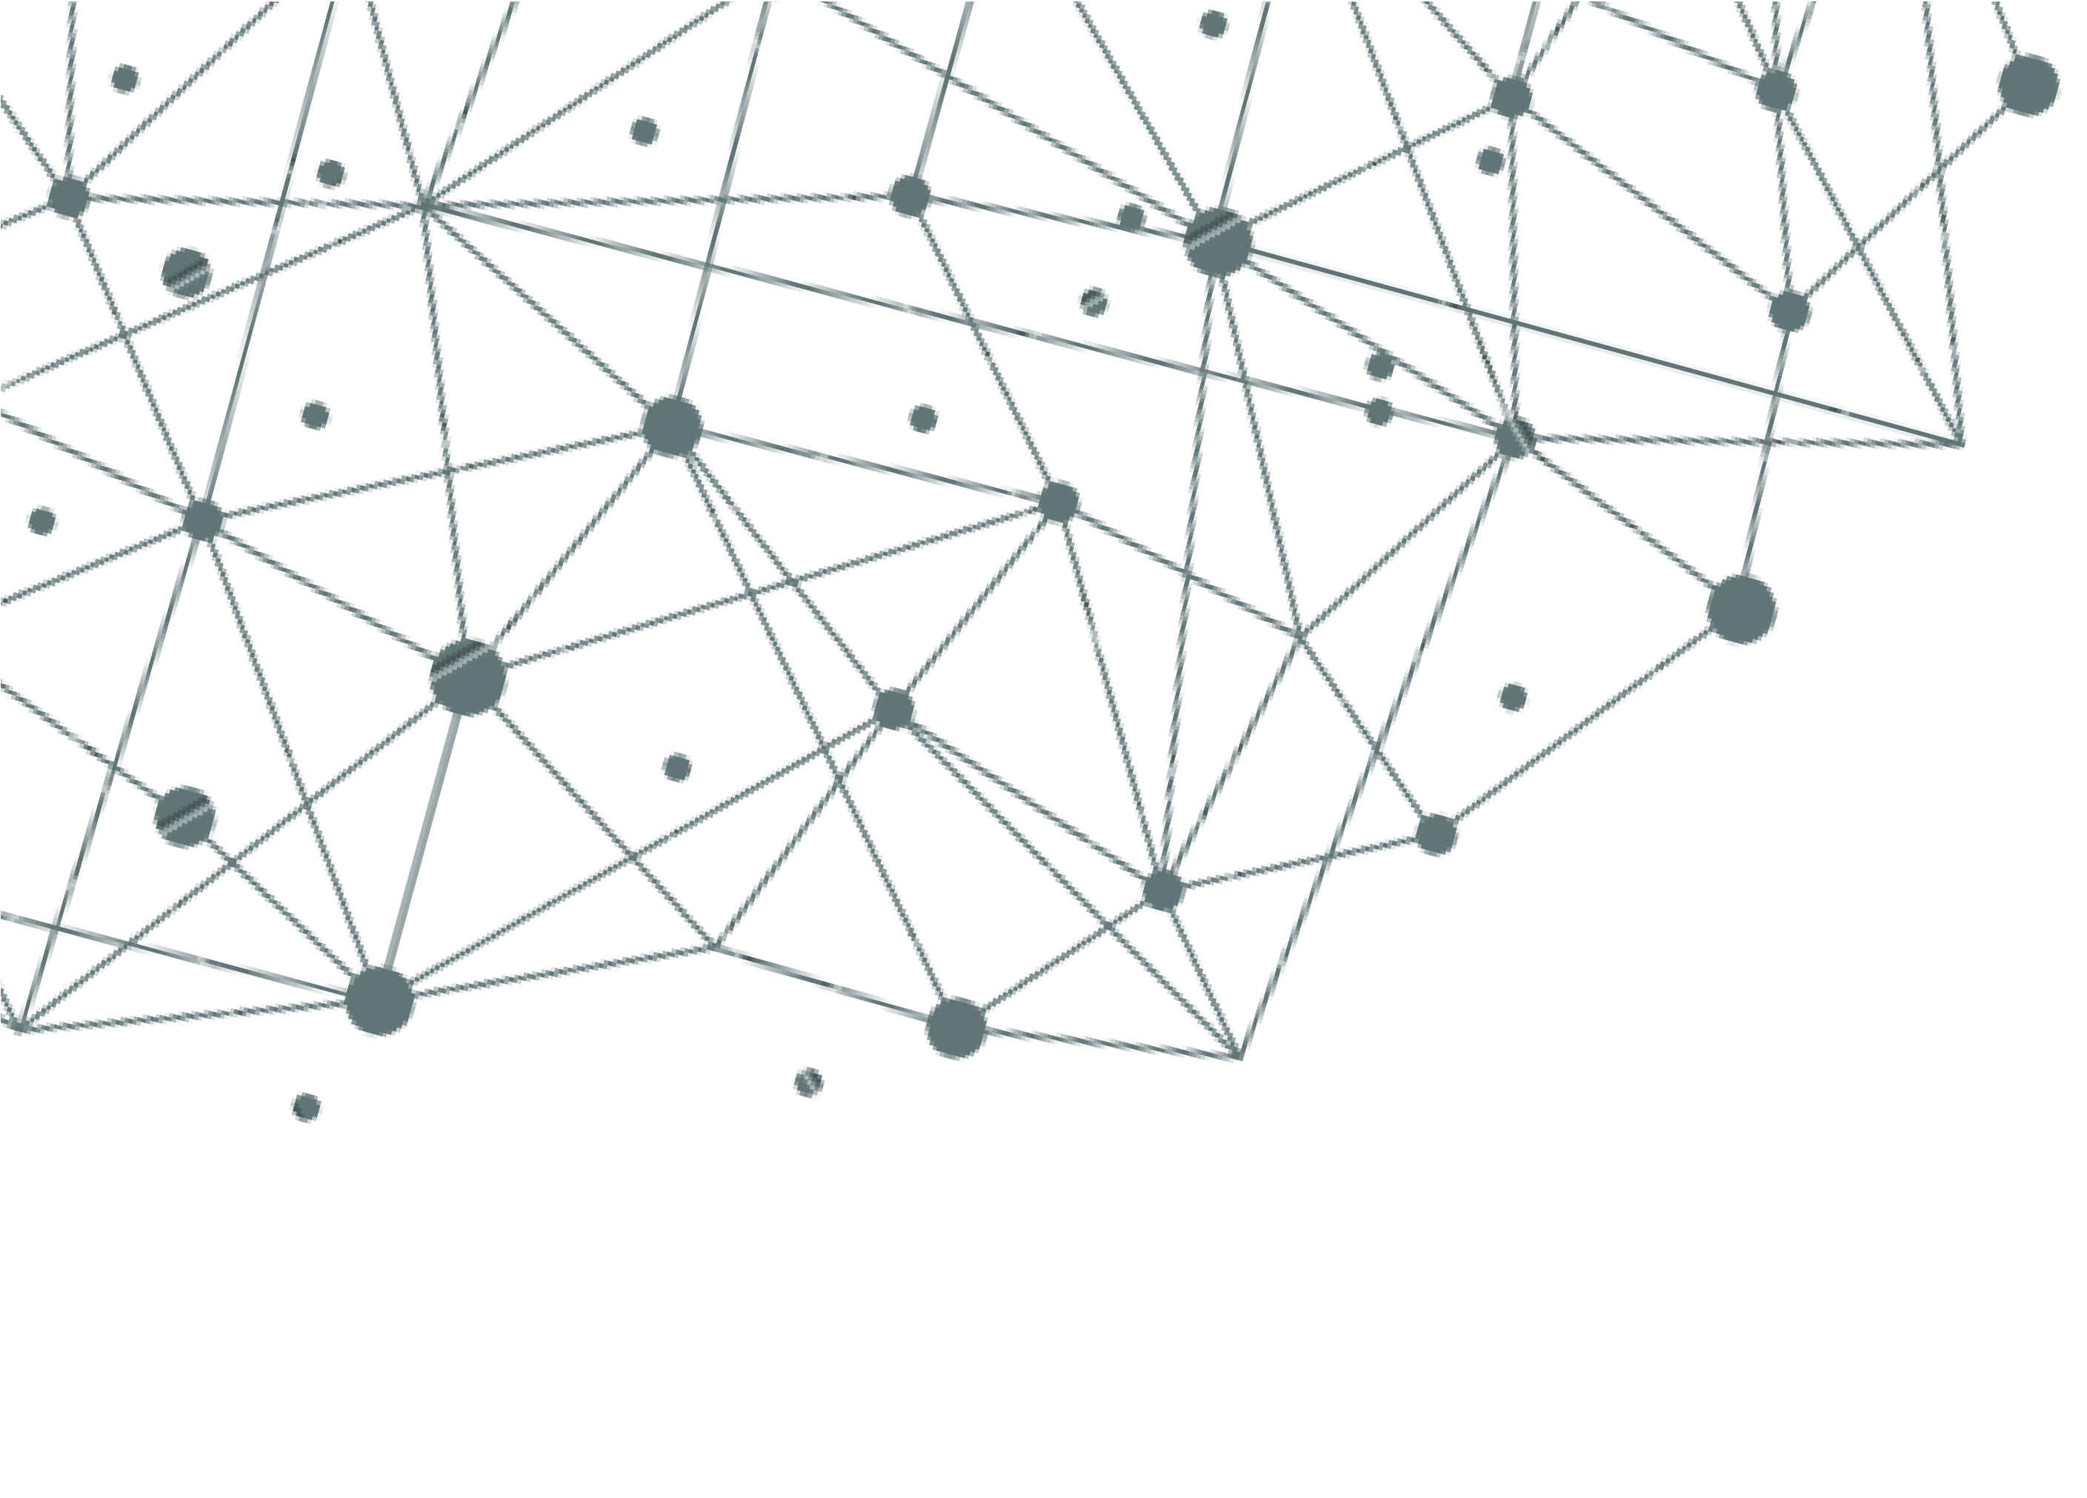

GENERATIVE AI
JUNK FOOD CLASSIFICATION
USING CONVOLUTION NEURAL NETWORK

Slide 3
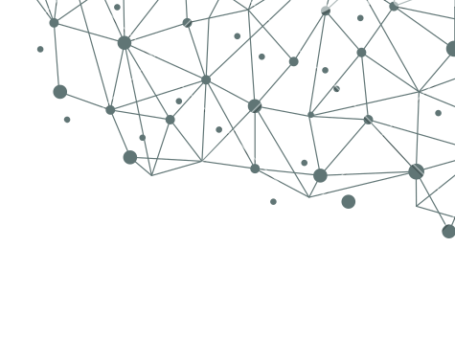
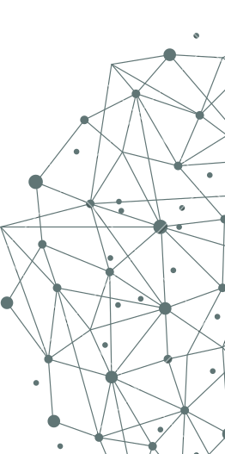
AGENDA
The proliferation of Junk-food establishments worldwide has led to a diverse and extensive menu landscape, making it challenging for consumers to make informed and healthy food choices. The objective of Junk food classification is to develop a system that can automatically identify and categorize images containing different types of Junk food. Junk food consumption is a prevalent dietary trend. This can be achieved using deep learning techniques, particularly convolutional neural networks (CNNs).
This project has the potential to be applied in various contexts, such as: Dietary Tracking Applications: Users can upload pictures of their meals, and the system can classify the food items, potentially providing feedback based on their dietary goals.
Automated Junk Food Image Analysis: The system can be integrated into restaurant operations to streamline processes or analyze customer preferences.

Slide 4
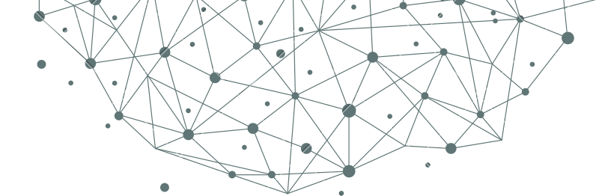

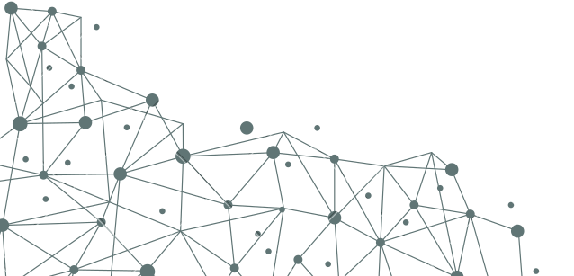
PROBLEM STATEMENT
This project revolves around one of my greatest passions: food!
Junk food is a convenient choice for many individuals due to its convenience and accessibility. However, the health implications of consuming Junk food regularly are well- documented, leading to a growing interest in understanding and managing dietary habits.
The problem to be addressed is the classification of various Junk food items and their visualization. This classification can be used in assisting consumers in making informed choices about their food consumption and to raise awareness about the nutritional value of different Junk food options.

Slide 5
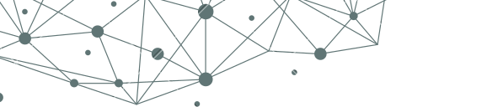
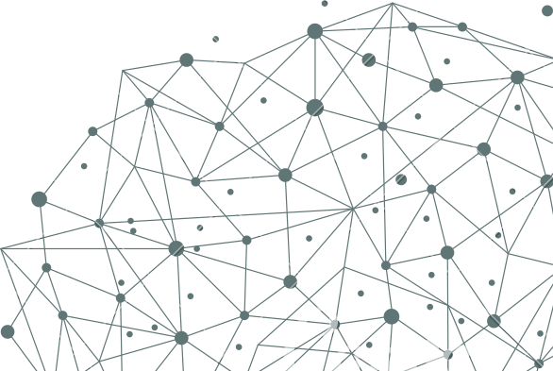

OVERVIEW
This project aims to develop a system that automatically classifies images containing different types of Junk food using CNNs. This project aims to classify Junk food images based on nutritional values.
Here's a breakdown of the key steps in Junk food classification using deep learning:
Data Collection Data Preprocessing Model Building Model Training Data Visualization Model Evaluation

Slide 6

Who are the end users?
Individual Users:
Diet-conscious individuals
Nutritionists and Dietitians
Fitness professtionals Businesses in the Food Industry:
Food Service Providers
Gym
Food Manufacturers and Suppliers
Mobile Health (mHealth) Platforms Government agencies
Public Health Organizations
Technology and Data Science Professionals
Fitness app Developers
Data scientists and Data analysts

Slide 7

SOLUTION
Our solution for Junk food classification leverages machine learning techniques to categorize Junk food items and visualize them using Convolution Neural Network, and ResNet50V2
VALUE PROPOSITIONS
Informed Decision-Making: Empowers consumers to make healthier Junk food choices based on detailed nutritional information.
Professional Support: Assists health professionals in educating
clients about Junk food nutritional content, facilitating better dietary guidance.
3. Industry Improvement: Enables food businesses to develop
and promote healthier Junk food options, meeting consumer demand for nutritious choices.
Public Health Impact: Supports public health efforts by monitoring Junk food consumption trends and implementing targeted interventions to address diet- related health issues.
Convenience and Accessibility: Provides a user-friendly
interface for easy access to Junk food classification results.

Slide 8
THE WOW IN MY
60
SOLUTION
50
Emphasize that our solution can recognize a broad range of Junk food items, going beyond the basic burgers and fries.
Identify a wide variety of Junk food items with high accuracy. (e.g., burgers, fries, pizza, tacos, donuts, etc.)
Leverage transfer learning to achieve state-of- the-art performance without massive datasets. Offer real-time classification capabilities for applications like dietary tracking or Junk food ordering systems.
Potential for customization to include specific food items from different restaurant chains.
40
30
20
10
0
Taquito
Taco
Burger
Fries
Pizza
Crispy Chicken

Slide 9
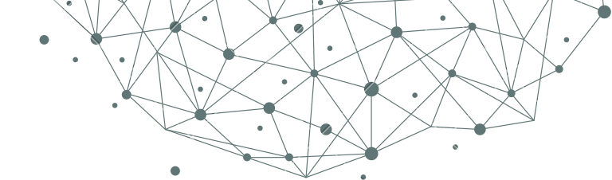

MODELLING
1 2
3
4
5
DATASET PREPARATION
NEURAL NETWORK ARCHITECTURE/ WORKING
TRAINING
TESTING AND VALIDATION
Prediction:
Dataset serves as the training material for the neural network to learn the distinctive features
Convolutional Neural Networks (CNNs) are commonly used for image classification due to their ability to capture spatial hierarchies and patterns.
The neural network analyzes the input images
the model is tested on a separate set of images not used during training, called the validation or test set.
Once trained and validated, the model can be applied to new, unlabeled images for classification
Transfer learning: Leverage pre-trained models (e.g., VGG16, ResNet50) Reduce training time and improve accuracy
Fine-tuned for Junk food image classification task

Slide 10
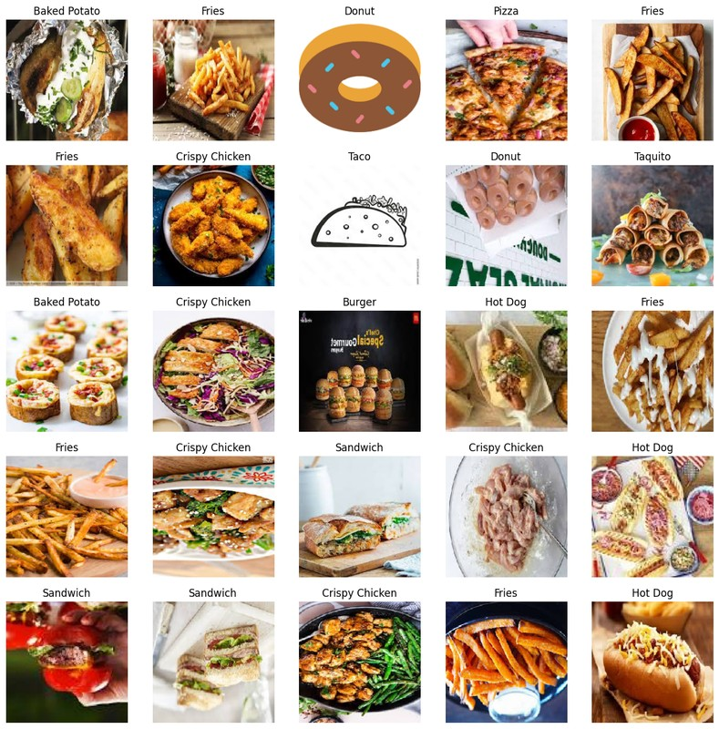
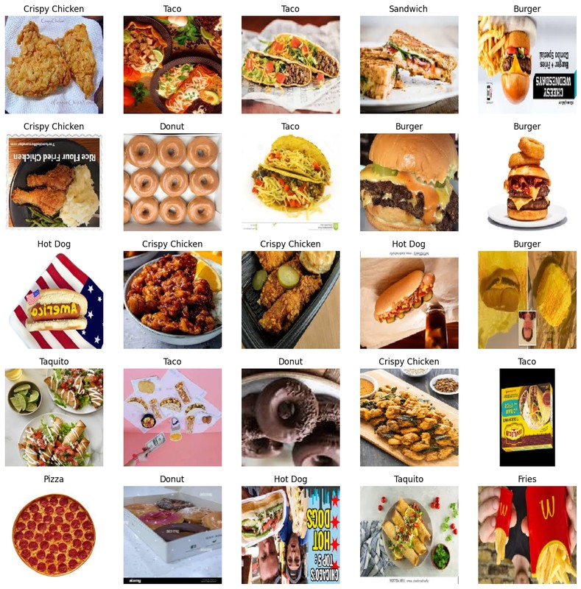
OUTPUT
Data visualization

Slide 11
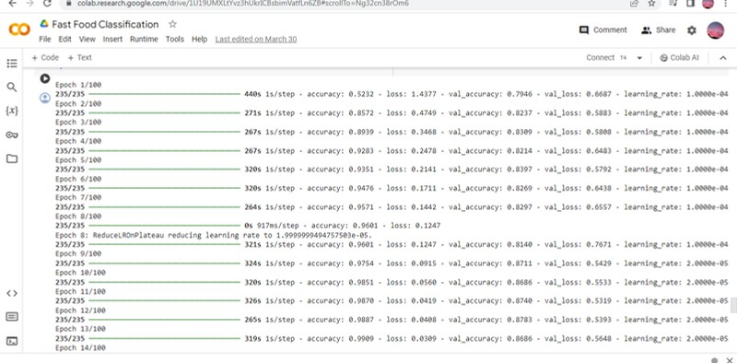
ResNet50V2- MODEL COMPILATION AND TRAINING

Slide 12
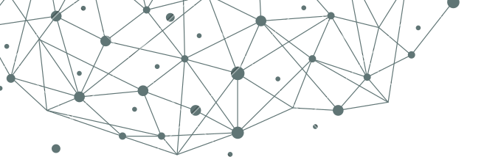
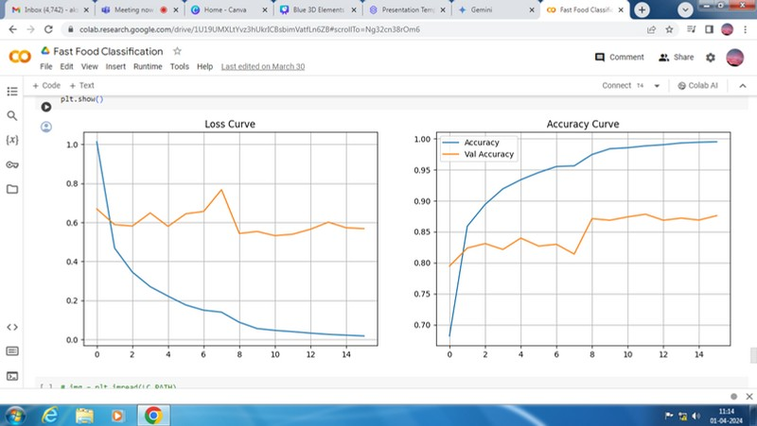
RESULTS
High accuracy
Visualization: High level image visualization
It can be used for Versatile applications such as Diet apps, Food chain etc,.

Slide 13
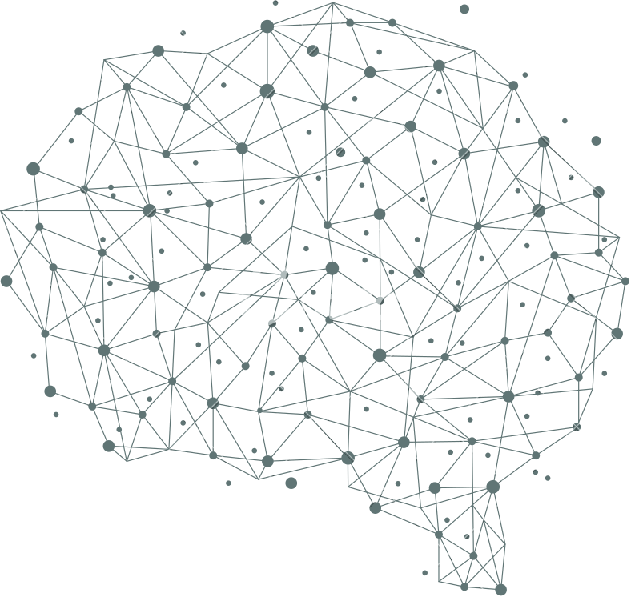

THANK YOU

